Slide 1
Spatial Characteristics of Irrigated Cropland in the South Platte River Basin
Miles Rollison
12/09/2019

Slide 2
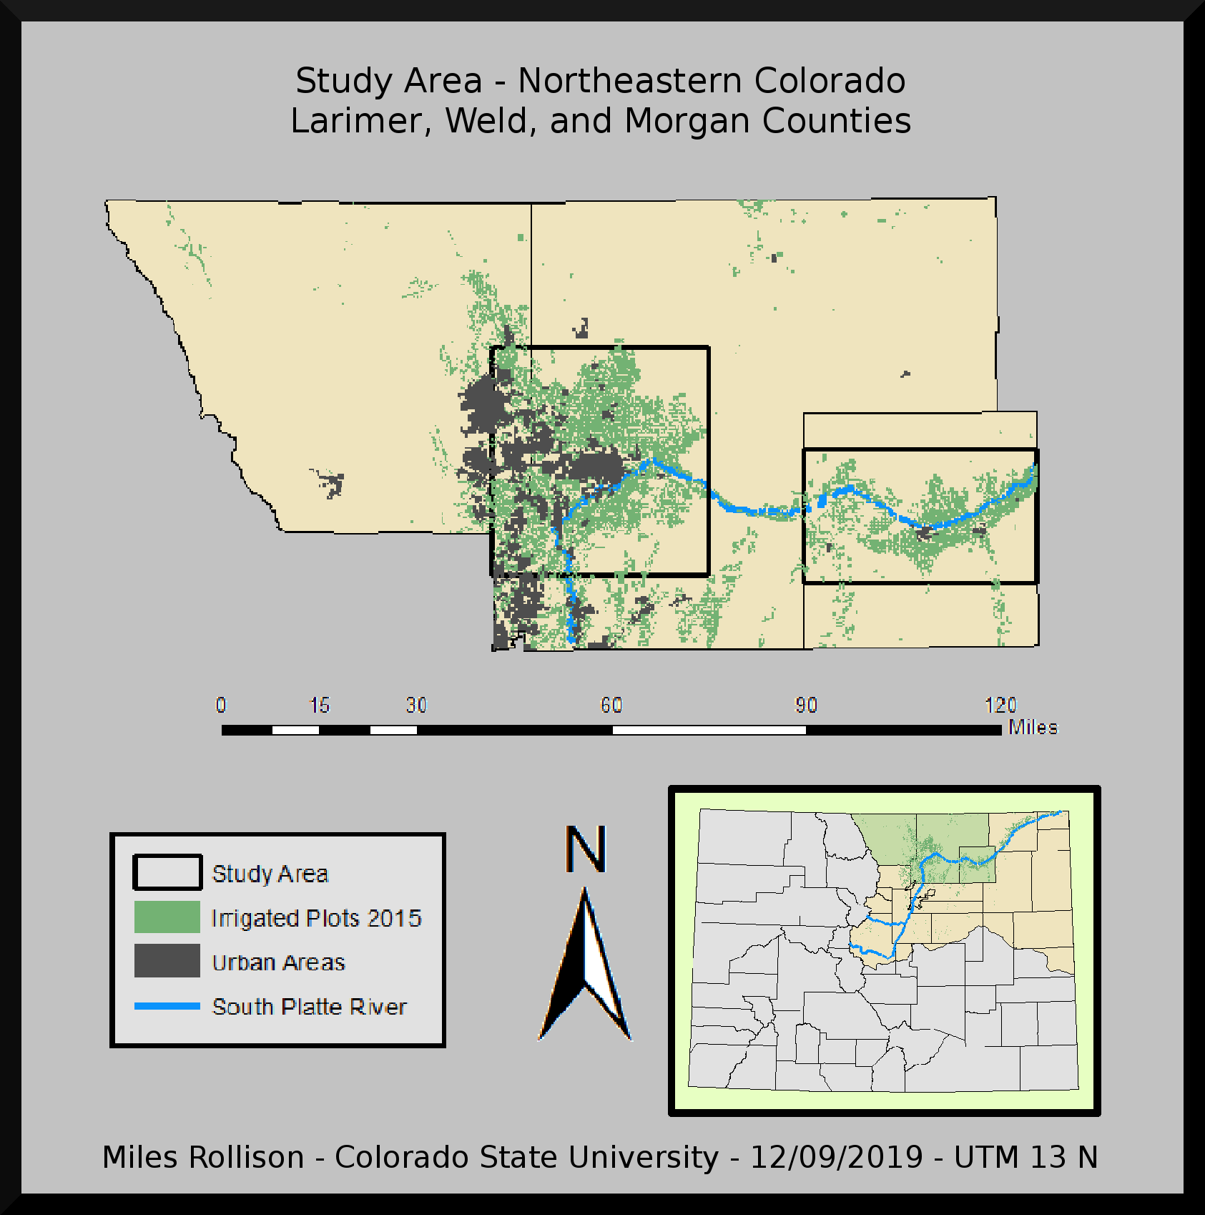

Slide 3
Motivation
Global Trends
Increasing global population -> Higher demand for food
Increasing global development/income levels -> Increased demand for meat
Local Trends
Increasing local population -> Urban encroachment on productive ag land
Climate change -> Increased aridification -> Decreased grazing capacity
Simplified landscapes resulting from conventional agriculture not sustainable
Beef production in US is very efficient and can be an environmental net positive with suitable management practices
Perennial crops often have more optionality and can act like natural insurance in a way that annual row crops can not.

Slide 4
Research Context
Several field or farm level economic studies but few thorough studies that focus on a larger area
Most of the studies that are situated in a larger spatial context focus on programs like CRP
Several ecology studies in a landscape or watershed context
Sparse literature focusing on how to incentivize conservation sustainable practices without government programs
Most studies look at bioenergy crops in the US Midwest

Slide 5
Research Objective
Exploratory analysis:
What does the agricultural landscape currently look like
Are cropping types clustered together and what does this indicate for openness to new cropping strategies?
Do some crops tend to be grown near each other or away from each other?
How does this change across time?
How similar are the data from 2010 and 2015?
Are cropping decisions more static or do they change from one period to the next?
Highlight areas of interest for further investigation
E.g. clustering around infrastructure or clustering of two crop types

Slide 6
Why Colorado is a Good Case Study
Colorado has 7 water divisions that correspond very closely with reporting regions for most relevant USDA data on yields and prices
The GIS data for these 7 divisions is well organized and readily available
Colorado water law allows for transference of water rights separate from surface land use rights, leading to many scenarios that are not legal in other states - “Buy and Dry”

Slide 7
Why South Platte River Basin is a Good Case Study
Heterogeneity in agricultural operations
Urban-rural divide and transition
High incidence of buy and dry reducing surface water irrigation options
Groundwater issues
Declining aquifer levels
Salinization

Slide 8
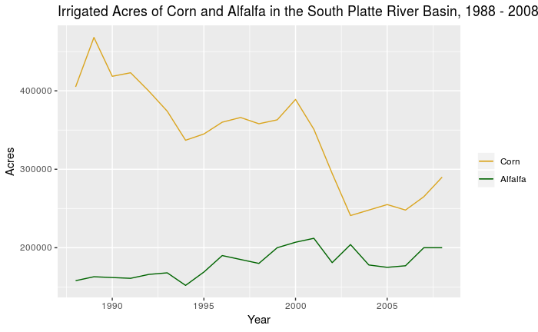

Slide 9
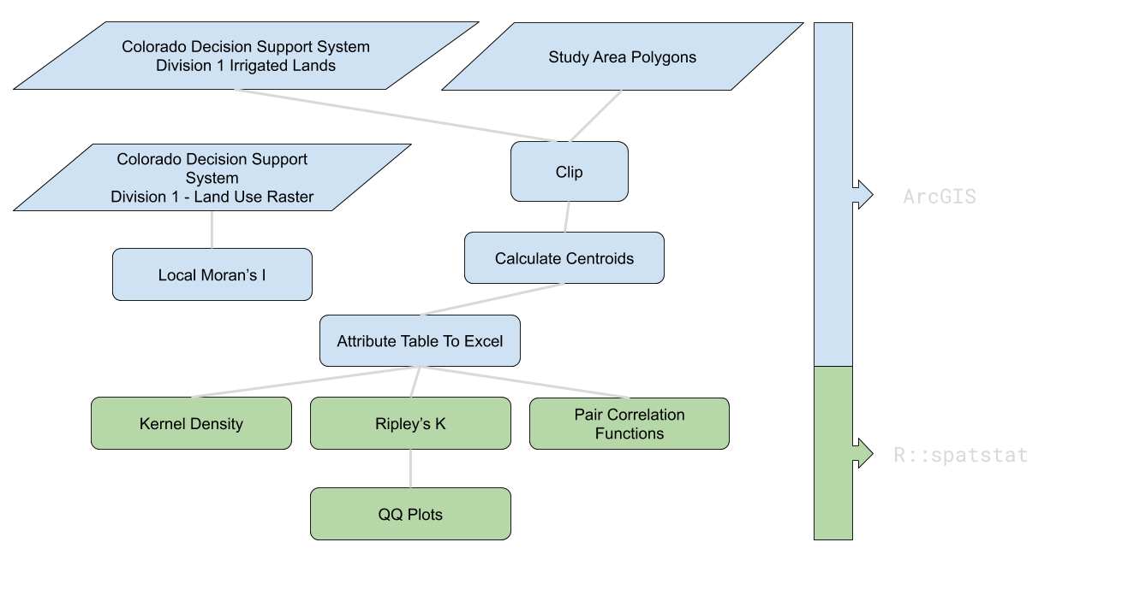
Methods Flowchart

Slide 10
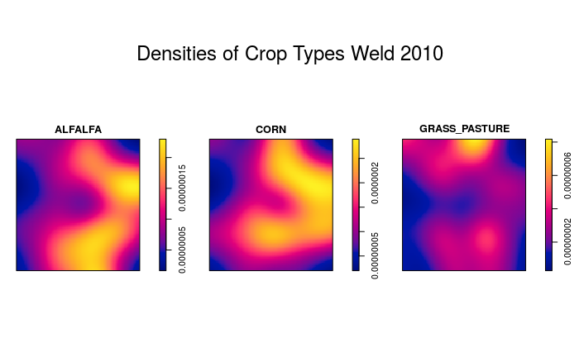

Slide 11
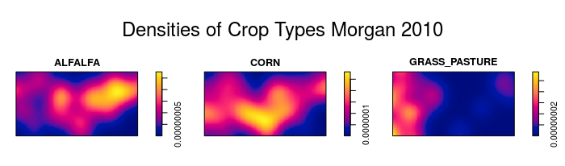
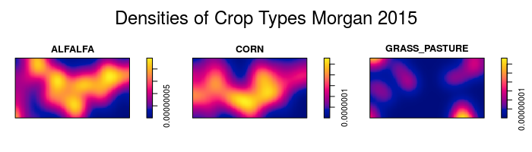

Slide 12
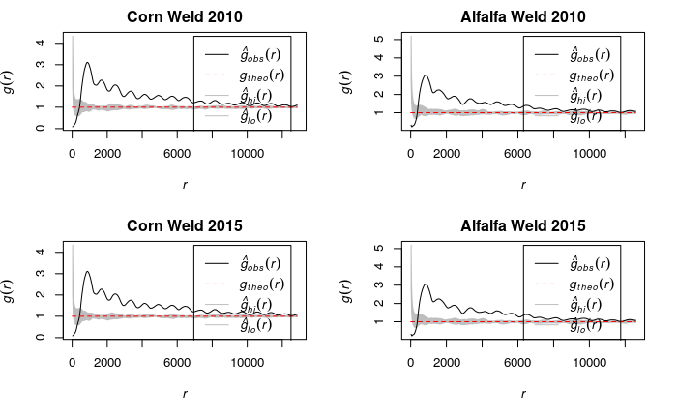
Univariate Pair Correlation - Weld County

Slide 13
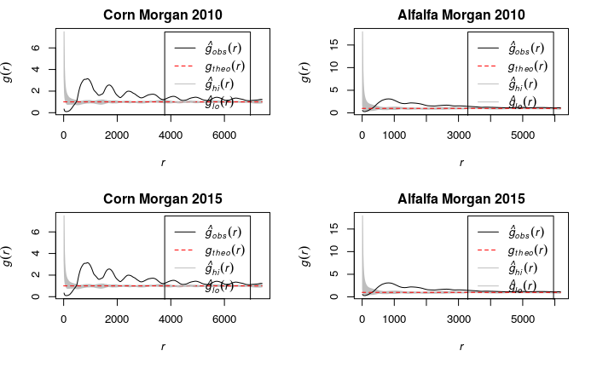
Univariate Pair Correlation - Morgan County

Slide 14
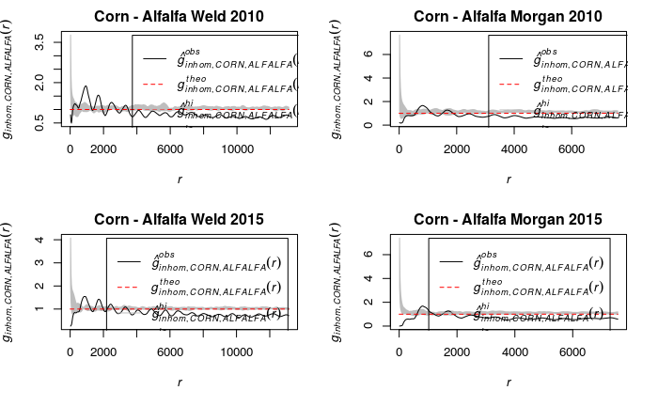
Bivariate Pair Correlation

Slide 15
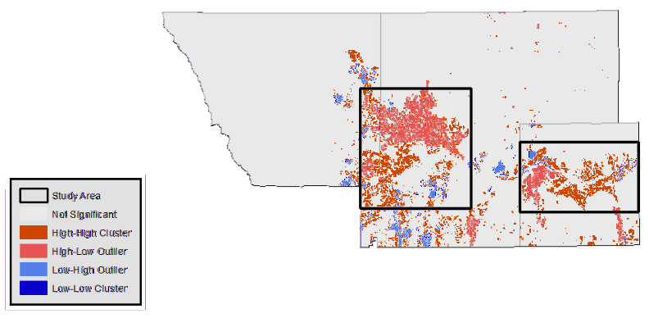
Moran’s I - Row Crops

Slide 16
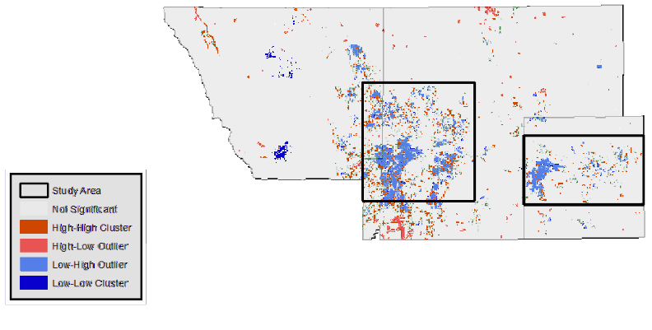
Moran’s I - Forage

Slide 17
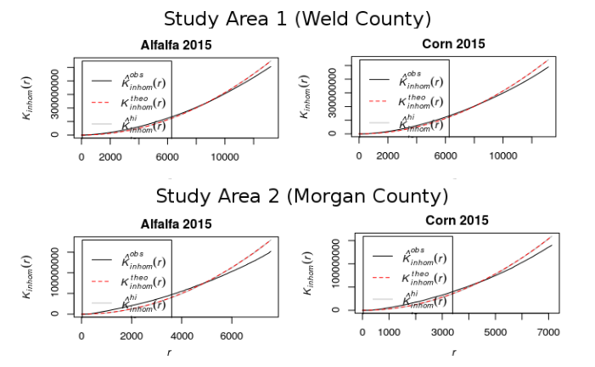
K Function
Notes:
Clustering at short distances, dispersion at longer distances

Slide 18
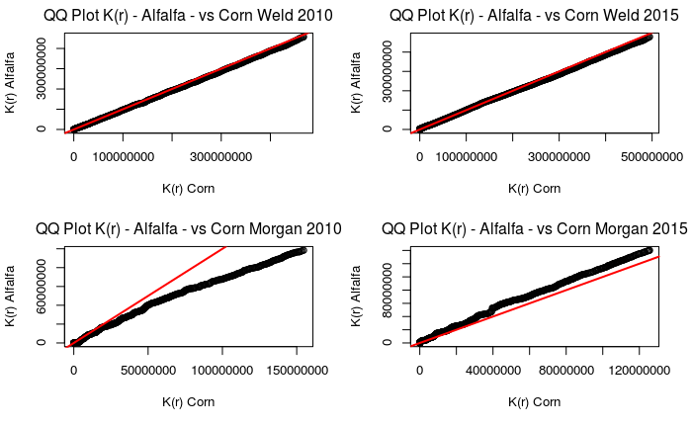
K Function Comparisons Across Crops

Slide 19
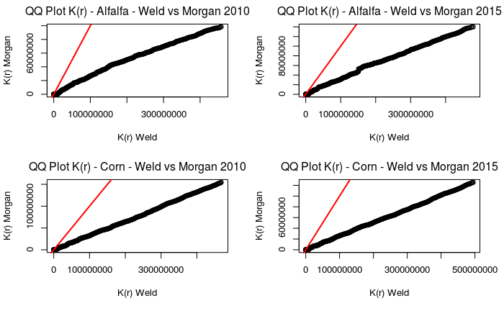
K Function Comparisons Across Counties

Slide 20
Research Takeaways
Cropping Patterns are qualitatively different in Weld and Morgan Counties
This region may benefit from more granular analysis
Diversification strategies may not be as important in Weld county
Relative cropping intensity in Morgan County was noticeably different in 2015 from 2010
Possibly more susceptible to marginal effects from changes in economic variables
Possible “attraction” between corn and alfalfa at short distances of about 1-2 fields away
Need to incorporate ownership data to determine if this is due to diversification strategy or other causes (or random chance)

